Slide 1
How to Improve Legacy Code
David Sackstein

Slide 2
Overview
Module 1 presents the principles, but how are those principles applied in practice?
In Module 2 we learned that one of the benefits of tests is that they reduce the risks involved in refactoring existing code.
But legacy code often has no tests - so refactoring may easily introduce bugs. Worse, code with no tests is often not testable, that is, we must refactor it in order to enable us to introduce tests.
This vicious cycle often leads to stagnation, and over time, bad code degrades further, becoming increasingly brittle and harder to maintain.
The recommended approach in such cases is to make incremental changes. Adding a test, doing some refactoring and then adding more tests.
This module is a coding demonstration, which begins with a working project which has issues.
In an open discussion, we will identify the issues and then I will demonstrate the incremental approach to resolving them.

Slide 3
Agenda
Problems with legacy code
Evolution of legacy code
How to make minimal changes
How to test code without a clear API
How to add tests incrementally

Slide 4

Recommended Book on this Topic

Slide 5
Problems with Legacy Code
Legacy code is often over complex due to quick and dirty changes made over time resulting in:
Highly coupled components
Violations of the Single Responsibility Principle
Violations of encapsulation
Inheritance all over the place
Our manager will not let us change legacy code because “If it works, don’t fix it”
Legacy code typically does not have tests so we can’t safely change it, anyway.

Slide 6
Working with Legacy Code
Betty bought a bit of butter but the butter was bitter, so she bought a better bit of butter, put it with the bitter butter, and made the bitter butter better.
The legacy code is bitter, so write new code, with tests that adheres to the principles we are learning, and your code base will incrementally improve.
This is because the churn (rate of change) of code decreases with time so after a year, most of the code you will need to change will be new code.
The challenge is then to make sure that the changes you make during the year preserve its quality.

Slide 7
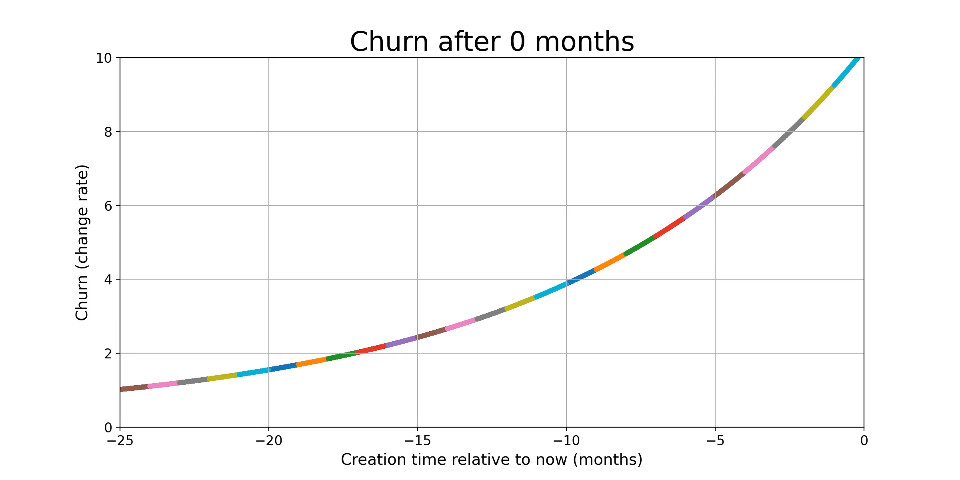
Evolution of Legacy Code

Slide 8
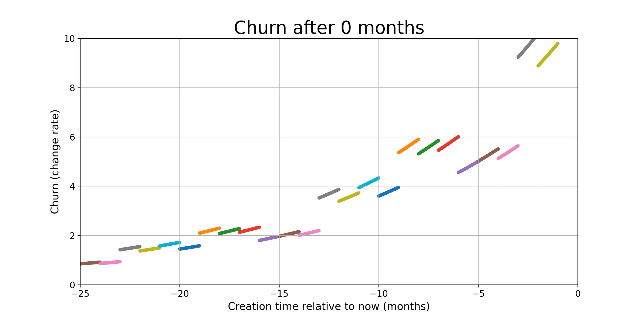
Evolution of Legacy Code

Slide 9
General Approach
The approach is not to rewrite legacy code
There is generally no need, as it gets older:
The need to maintain it decreases
The probability of breaking it increases.
Make small incremental changes.
Add a test, do some refactoring
Add more tests

Slide 10
Sprout Method or Sprout Class
Create new functionality in a new method or class.
Do not copy the style and fallacies of the legacy code. Don’t mimic just for consistency.
Modify just a few lines from the legacy code so it can call the new code.
Demonstrate in a review that
The changes to the existing code were minimal
The new code is well tested.

Slide 11
Difficulties writing tests
The public APIs are not well-defined so we cannot run a test that calls them.
For instance, they are called in varying order from different parts of the system
There are hard dependencies that are not conducive to testing, for instance:
External systems that are not available during tests (e.g. database and network devices)
Systems that are not deterministic (making our tests not repeatable)

Slide 12
Addressing unclear APIs
Write Characterization Tests
A test that runs the code and captures its current behavior.
The behavior should be a part of the system that would certainly change if the system functionality were changed.
For instance:
Define an interface for a logger.
Make a minimal change to the code to inject the logger.
Inject an implementation that records all logs to a file.
Run the code and verify that the recorded logs did not change.
This can be done in a non-test environment at first

Slide 13
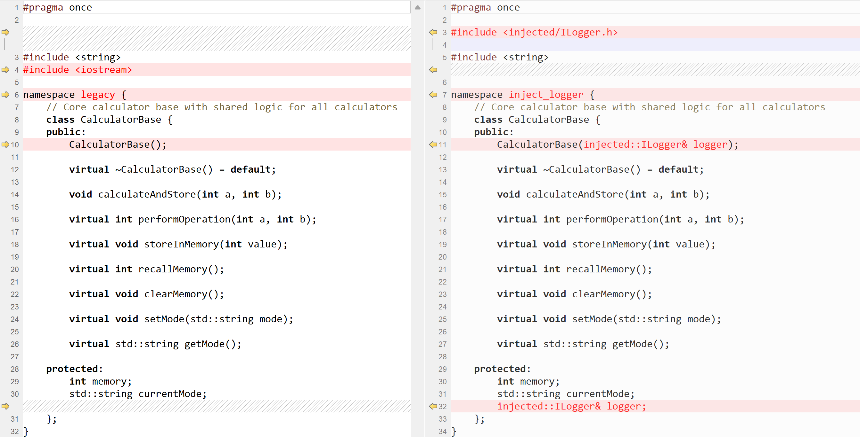
Inject an ILogger

Slide 14
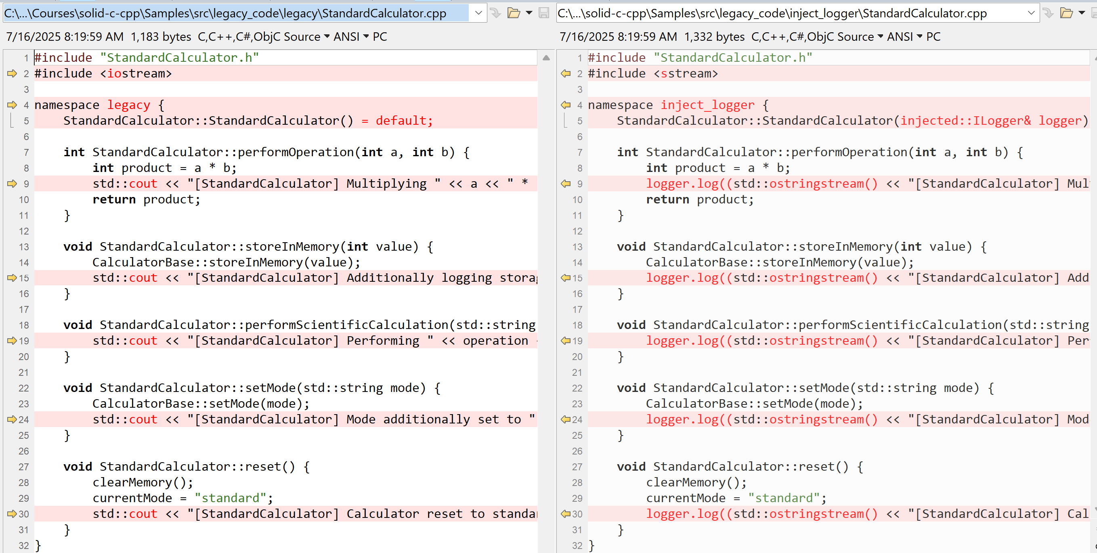
Intercept logs

Slide 15
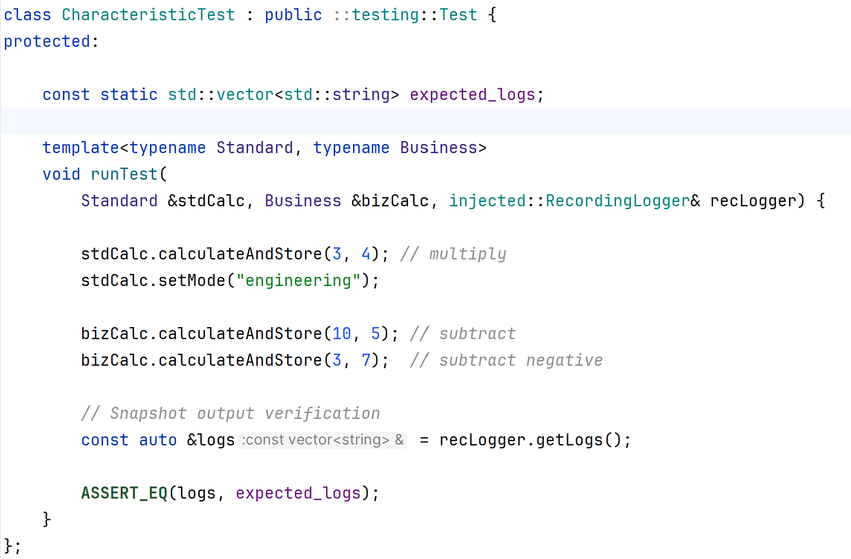
Record and compare logs

Slide 16
Addressing hard dependencies
Mocks and stubs will help here:
Inject interfaces to constructors
Replace the hard dependencies with simple mocks that allow the tests to run.

